Slide 1
SOFTWARE ENGINEERING
WRITE EFFECTIVE
USER STORIES

Slide 2

EXPLAIN
User stories are short descriptions of an application feature from the perspective of a user
As a Shop owner, I want to locate an item in the shop so that I can pick it up
+
+
WHO
WHAT
WHY

Slide 3




EXPLAIN
A User Story includes a need from a user of the application
Is this a user story?
I need to check student attendance
I need to notify Social Affairs that I’m sick
I need to find data about our users
I need to make sure the code of the application is maintainable
Social
Affair
Student
Project
Manager
Developers

Slide 4
EXPLAIN
A user story includes a benefit the user gets
Is this a user story?
I need to check student attendance
so that I can keep track of who needs help
I need to notify Social Affairs that I’m sick
so that I can be excused from class
I need to find data about our users
so that I can see if our app is reaching its audience
I need to make sure the code of the application is maintainable
so that we can maintain it easier
Social
Affair
Student
Project
Manager
Developers

Slide 5
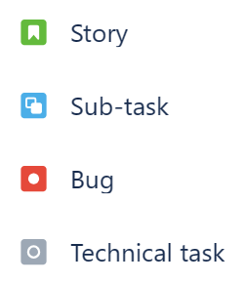
EXPLAIN
Story or Technical Task?
When task tracking in a tool like JIRA, we label Stories, Technical Tasks, and Bugs differently.
Technical Tasks and Bugs can also be broken down into sub-tasks, but they are not part of the requirements gathering process.
Probably a Tech Task
Review the project structure and repo, to make sure the code is maintainable
User Stories | Tasks & Sub-tasks
Describe what | Describe how
A piece of functionality from the point of view of the user | Actions we need to do to deliver User Stories
Developers

Slide 6
EXPLAIN
Good User Stories
Unambiguous - it should be clear to the reader; have only one meaning
❌ “I want to like things and see those things later”
✓ “…I want to Like users’ posts, and view a list of posts that I’ve Liked…”
Consistent – the goals of the story should not contradict (oppose) the goals of the product
❌ “…I want to like posts so the ones I don’t like are deleted from the system”
✓ “…I want to like posts so that my feed doesn’t contain posts I don’t like.”
Straightforward – simple, not too complex
❌ “I want to like posts and have the ones I like most printed through a photo printing service and made into a book.”
This suggests that the requirement hasn’t been understood enough.
Not Duplicated – we don’t want two developers solving the same problem
❌ “I want to Like posts so I can have a history of the ones I Like”, and,
“I want to Favourite posts so they appear in my Favourites list.”
Examples taken from theserverside.com

Slide 7
EXPLAIN
Good User Stories
Testable – if you story can’t be tested, how do you know if it’s done?
❌ “…I want the system to only show me good posts”
✓ “…I want the system to only show posts that have been liked by users that I trust…”
Complete – includes role + need + benefit
❌ “I want to Like posts”
✓ “As a user, I want to Like posts so that I can show appreciation and save them for later.”
Not Too Big – the story should be small enough to complete many stories within one Sprint.
❌ “…I want a social media feed that displays all my friends’ posts and photos and provides recommendations…”
A story can be straightforward but still too big, e.g. “interview every student in PNC and report results”
Not Too Small – the story should be big enough to be worth the design/code/test cycle
❌ “…I want each post to display its title…”
Stories are not Developer Tasks – we divide stories into subtasks later, or create whole Tech Tasks.
❌ “As a developer, I want to create a function that handles clicks on the Like button, so that the user can Like posts.”

Slide 8
Reminder…
Unambiguous
Consistent
Straightforward
Testable
Complete
Not Duplicated
Sized
“What”, not “How”

Slide 9

INSTRUCTIONS
Which of these are Good and Bad examples?
In your teams, read each User Story.
Decide whether it’s good or bad.
Write your team number under either the “Good” or “Bad” column
Be ready to explain why at the end!
Refer to Exercise User Stories – Good or Bad.docx

Slide 10
Exercise Review

Slide 11
SOFTWARE ENGINEERING
ACCEPTANCE CRITERIA & DEFINITION OF ‘DONE’

Slide 12
EXPLAIN
What does “DONE” mean?
It works on my machine

Slide 13
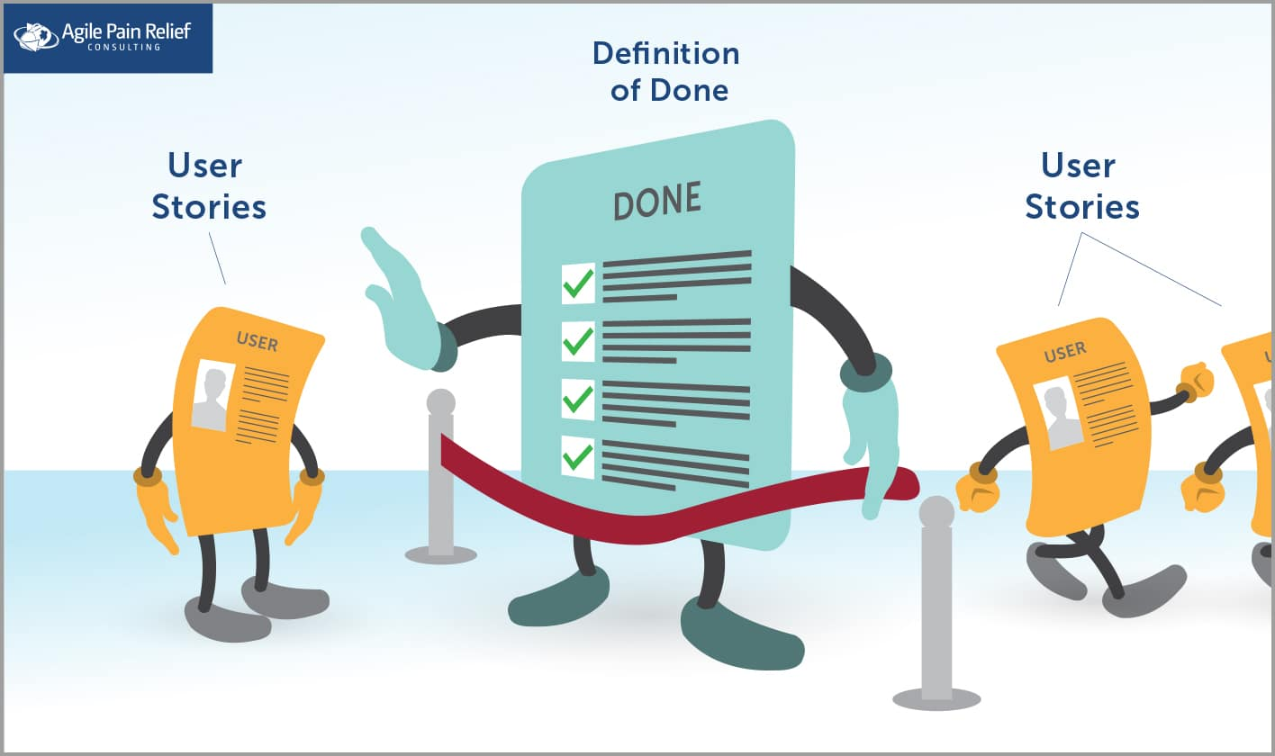

Slide 14
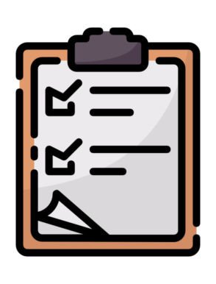
INSTRUCTIONS
What other things should we do to call the story “DONE”?
In your teams, make a list of everything you should do before you can call a story DONE in JIRA.
Take 10 minutes to make the list, and be prepared to share with the class.

Slide 15
Exercise Review

Slide 16
REVIEW
What other things should we do to call the story “DONE”?
Did you list any of these?
Tests written to cover the User Story
Usability Review Completed
Code committed to a git branch with suitable comment
Code Peer Reviewed on the git branch
Tested on Chrome, Edge, Firefox… (Android, iPhone, iPad…)
Tested at different screen resolutions
All other Tests run
Git branch merged
End-User Documentation has been updated
…anything else?

Slide 17

EXPLAIN
What are Acceptance Criteria?
Is this what you wanted?

Slide 18
EXPLAIN
What are Acceptance Criteria?
Story: “As a customer, I want to search for shows, so that I can decide what to watch.”
Acceptance Criteria:
The search page should be reachable from the main screen.
If customer selects dates in their search, display shows for those dates, and no others.
If a customer uses a search string, display shows with titles matching that string, and no others.
The results page should display the show name, description, dates and times.
If there are more than 30 results, they should be displayed across multiple pages, with “Previous” and “Next” buttons.
If there are zero results, a message should display “No matching results found.”
If a show is sold out, it should appear in the results with a “SOLD OUT” sign by it.
Search results should appear within two seconds of the user pressing the Search button.

Slide 19
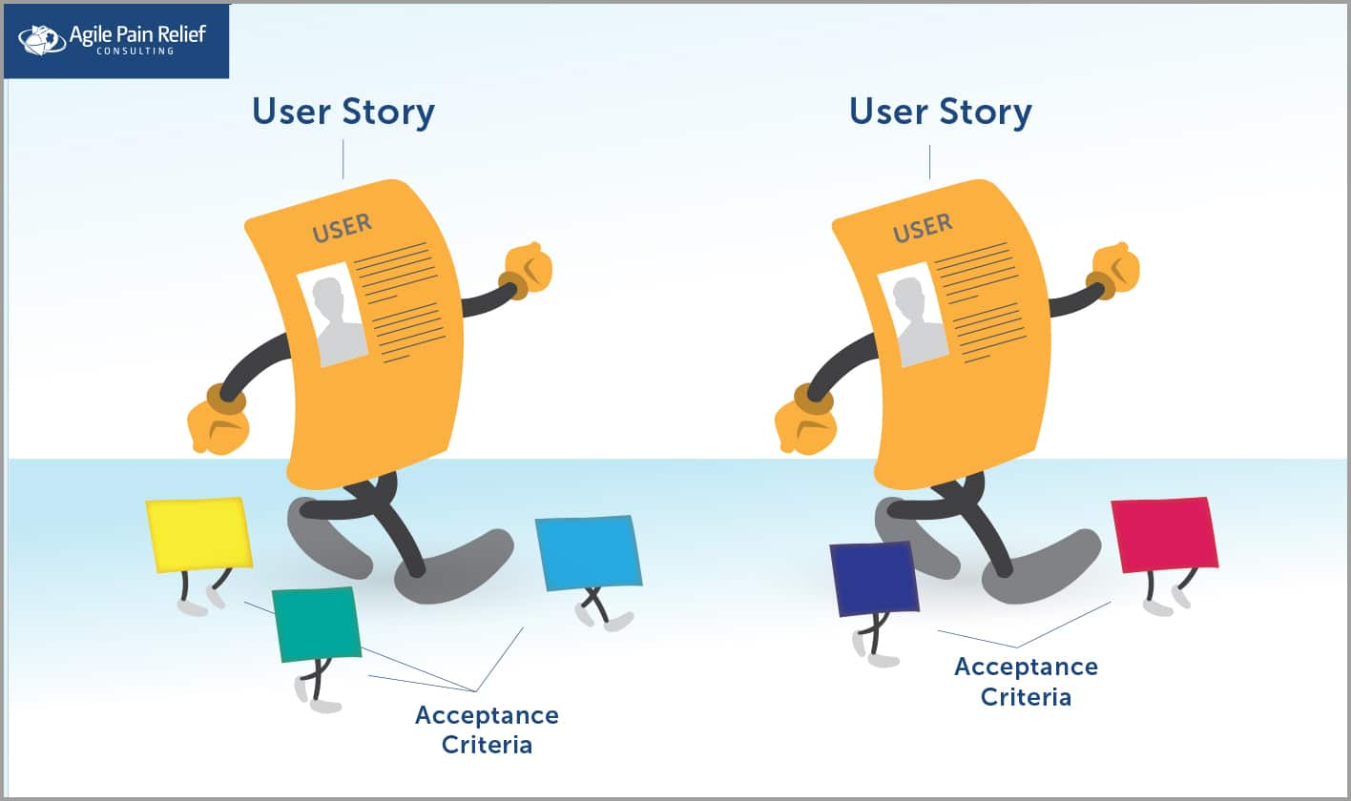
EXPLAIN
Definition of Done is usually the same for every story in a project.
(it might be different for a different project)
Acceptance Criteria are different for each story.

Slide 20
EXPLAIN
Acceptance Criteria are not exactly Tests, but they can be broken down into Tests
Acceptance Criterion: ← singular form of Criteria. One criterion, many criteria.
If customer selects dates in their search, display shows for those dates, and no others.
Tests:
# | Test (what I do) | Expected Result (what the computer does) | Pass / Fail
1 | On a data set containing a full month of shows, search for one day | Display all shows for that day
2 | On a data set containing a full month of shows, search for a three-day period | Display all shows for those day
3 | Enter a start date that is later than the end date | Display an error message to explain
4 | On a data set containing a full month of shows, leave the date selection empty | Display all upcoming shows
We will cover tests in another lesson

Slide 21
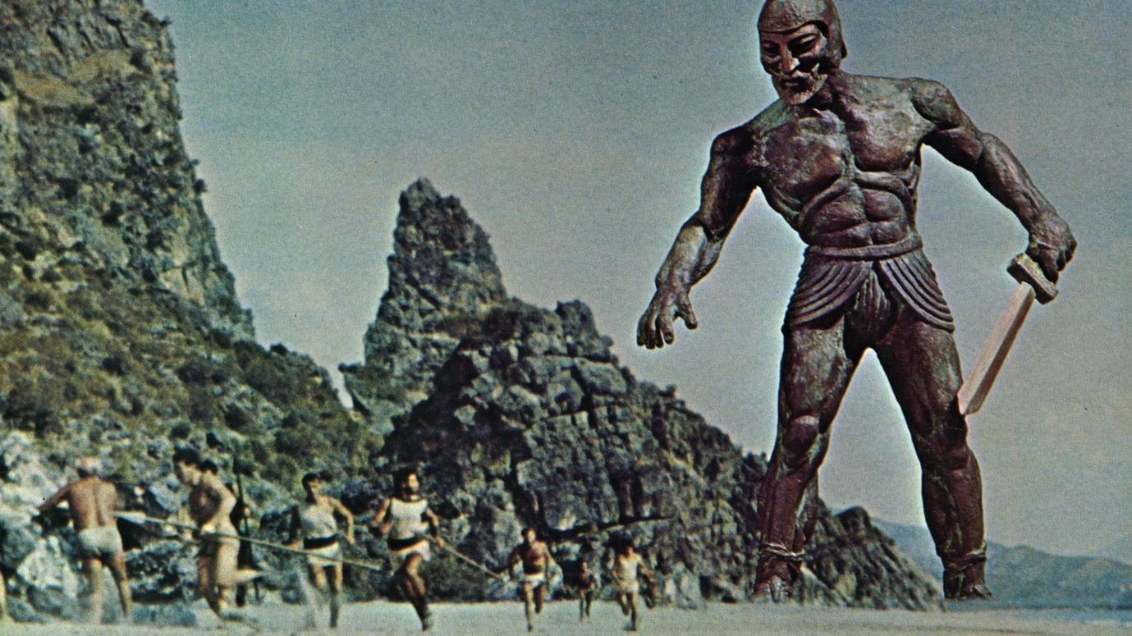
EXPLAIN
EPICS
In Ancient Greece, an Epic was a long story in poem form.
In Agile, an Epic is a collection of Stories that form a larger story.

Slide 22
EXPLAIN
Epics in Agile
An Epic’s title should be short, but it should still contain a full description, and use the same personas and goals as a story.
Epics can also be groups of Technical Tasks or even Bugs.
Epic Title: User Management
Epic Description: As a user, I want to perform common actions relating to my account. This includes create, update and delete, as well as lost password recovery. These should be on a page reachable from the navigation bar.
Story: As a user, I want to create a new account so that I can use the system.
Story: As a user, I want to check and update my account details, so they are accurate.
Story: As a user, I want to recover a lost password so that I can log into the system.
Story: As a user, I want to delete my account so that my personal details are not kept.

Slide 23
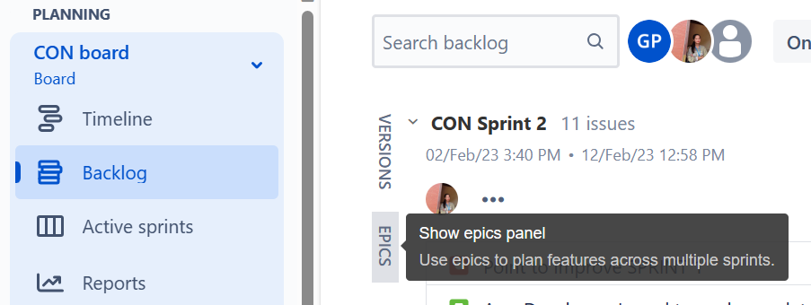
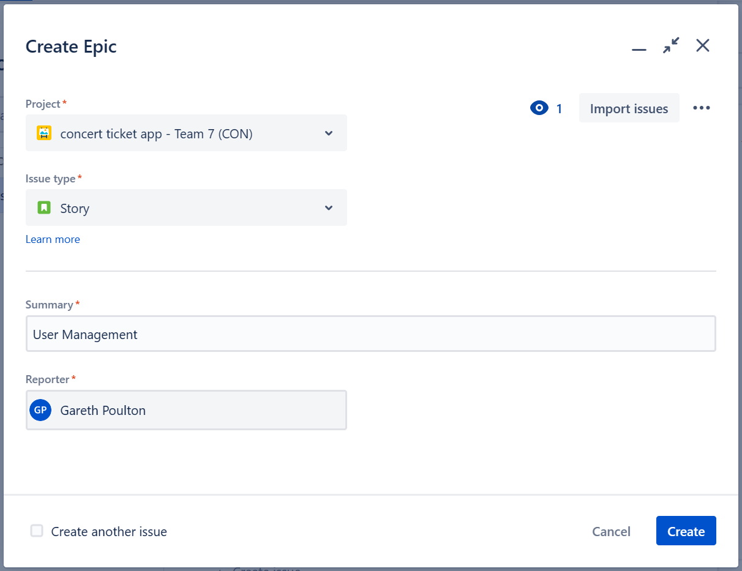
EXPLAIN
Epics in JIRA
Step 1
Step 2

Slide 24
QUIZ
Review
1. A Collection of Stories
2. A software defect
3. Activities to complete a story
4. A technical activity to enable the project
5. A description of a user need
6. Things we must do for every story
7. Things we must do in a story
Acceptance Criteria
Definition of Done
Epic
Story
Task
Bug
Sub-tasks

Slide 25
SOFTWARE ENGINEERING
STORY WRITING
& REVIEW

Slide 26
INSTRUCTIONS
Are you ready to begin your User Stories?
In your teams, write the first five User Stories for your project.
Write clearly so your classmates can understand!
After 30 minutes, give your stories to the team numbered below yours (team 2 give to team 1 etc)
Read the other team’s stories and write feedback
Are they understandable?
Do they meet the conditions of good user stories?
Remember, if your classmates find problems with your stories, you should thank them for helping you improve!

